Slide 1

EMPLOYEE WELLNESS BENEFIT ADMINISTRATION PORTAL

Slide 2


At present, the Finance Department at WealthOS Lanka manages employee wellness allowances through a manual process.
PROBLEM
01
A PROBLEM WORTH SOLVING
The current manual, Excel-based claim review process limits employee visibility into claim status and significantly increases processing time for the Finance team.
CURRENT
PROCESS

Slide 3

02
OUR SOLUTION
WEB BASED WELLNESS MANAGEMENT PLATFORM
  Single, web-based system to manage all employee wellness allowances
  Replaces manual Excel sheets, emails, and paper-based tracking
  Acts as a single source of truth for employees, HR, and Finance
  Accessible across the APAC region through a secure web portal
Notes:
One trusted place to keep the real information
No more mismatched data or fixing errors by hand
Helps work run smoothly and keeps things well‑managed

Slide 4
03
KEY FEATURES
+123-456-7890
helllo@reallygreatsite.com

Slide 5
04
1. Employee Self Service & Visibility
  Anytime, anywhere claim submission from any device
  Claim submission with validations
  Supports Preventive & Curative care categories
  Secure upload of receipts and medical documents
  View Total entitlement, utilized amount & available balance
  Pending claims and claim status
Key Value:
  Reduces dependency on HR
  Improves transparency and employee satisfaction
Notes:
Less need to rely on HR for every task
Clearer processes that make employees Satisfy

Slide 6
05
2. Automated Policy Validation & Entitlement Management
  Automatic enforcement of wellness policy rules
    LKR 150,000 annual entitlement
    65% max Curative / 35% min Preventive allocation
  Prevents over-claiming and invalid submissions
  Pro-rated entitlement calculation for mid-year joiners
  Monthly accrual logic and annual reset
Key Value:
  Ensures fairness, accuracy, and policy compliance
  Eliminates manual corrections
Notes:
Keeps things fair, correct, and within the rules
No need to fix mistakes by hand

Slide 7
06
3. Approval Workflow & Automated Notifications
  Multi-stage approval flow: Employee → HR Head → Finance
  Role-based access control
  Rejections with comments for transparency
  Claim submission and approval/rejection alerts
  Finance settlement notifications
  Balance thresholds and deadlines
Key Value:
  Quicker response
  Well assigned duties with responsibility
Notes:
Quicker response and actions
Well assigned duties and with responsibility

Slide 8
07
4. Security, Compliance & Document Management
  Secure storage of receipts and medical documents
  Encrypted cloud storage with role-based access
  Complete digital audit trail
  Single Sign-On (SSO) and secure authentication
  Data encryption in transit and at rest
Key Value:
  Protects sensitive employee data
  Meets enterprise-grade security and compliance standards
Notes:
Keeps sensitive employee data safe
Follows strict security rules

Slide 9

08
5. Dashboards, Reporting & Cloud Native Architecture
HR & Finance Dashboards
  Pending verifications and approvals
  Employee claim history
  Utilization and financial liability overview
Reporting & Audit Readiness
  Monthly/annual utilization reports
  Pending vs. settled claims
Cloud-Native Architecture
  Mobile-responsive, no app installation
  Scales automatically during peak periods
Key Value:
  Faster decision-making
  Audit-ready, scalable, and cost-efficient
Notes:
Quick decision-making
Always ready for Audit, scalable, and cost-efficient

Slide 10
04
1. Centralized Wellness Management Platform
  Single, web-based system for managing employee wellness allowances
  Replaces Excel sheets, emails, and paper-based processes
  Acts as a single source of truth for Employees, HR, and Finance
  Securely accessible across the APAC region
Key Value:
  Eliminates data inconsistency and manual reconciliation
  Improves operational efficiency and governance
Notes:
Eliminates data inconsistency and manual reconciliation
Improves operational efficiency and governance

Slide 11
04
2. Employee Self-Service Claim Submission
KEY FEATURES
1. Centralized Wellness Management Platform
  Submit wellness claims anytime, from any device
  Guided, step-by-step claim submission with validations
  Supports both Preventive and Curative care categories
  Secure upload of receipts and medical documents
Value: Reduces dependency on HR for basic claim tracking
  Single, web-based system to manage all employee wellness allowances
  Replaces manual Excel sheets, emails, and paper-based tracking
  Acts as a single source of truth for Employees, HR, and Finance
  Accessible securely across the APAC region
Value: Eliminates data inconsistency and manual reconciliation

Slide 12
04
4. Automated Eligibility & Policy Validation
KEY FEATURES
3. Claim Status & Balance Visibility
  Automatic enforcement of wellness policy rules:
    LKR 150,000 annual entitlement
    Maximum 65% Curative Care limit
    Minimum 35% Preventive Care requirement
  Prevents over claiming and invalid submissions
Value: Reduces policy violations and manual corrections
  Employees can view:
    Total entitlement
    Pending claims
    Utilized amount
    Available balance (real-time)
  Claim status (will be discussed in next slides)
Value: Improves transparency and employee satisfaction

Slide 13
04
6. Multi-Stage Approval Workflow
KEY FEATURES
5. Pro-Rated Entitlement Management
  Structured approval flow:
    Employee → HR Head → Finance
  Role-based access control ensures approval integrity
  Rejection including comments
Value: Better management and responsibility
  Automatic allowance calculation for mid-year joiners
  Monthly accrual logic applied accurately
  Annual balance reset on January 1st
Value: Ensures fairness and financial accuracy without manual effort

Slide 14
04
8. Secure Document Management
KEY FEATURES
7. Automated Notifications & Alerts
  Secure storage of all receipts and medical documents
  Encrypted cloud storage with role-based access
  Easy access for audits and compliance
Value: Protects sensitive medical and financial data
  Email alerts for:
    Claim submission
    HR/Finance approval or rejection
    Finance settlement
    Balance thresholds and deadlines
Value: Reduces delays and eliminates manual follow-ups

Slide 15
04
10. Reporting & Audit Readiness
KEY FEATURES
9. Administrative Dashboards for HR & Finance
  Reports covering:
    Pending vs. settled claims
    Monthly and annual utilization
    Claim aging analysis
  Complete digital audit trail for all actions
Value: Simplifies audits and financial reviews
  HR Dashboard:
    Pending verifications
    Employee claim history
    Total Utilization
  Finance Dashboard:
    Approved claims pending payment
    Settlement tracking
    Financial liability overview
Value: Enables faster decision making

Slide 16
04
12. Security & Compliance by Design
KEY FEATURES
11. Mobile-Responsive & Cloud-Native Architecture
  Secure authentication with Single Sign-On (SSO)
  Role-based access (Employee, HR, Finance)
  Data encryption in transit and at rest
  Automatic session timeouts
Value: Meets enterprise grade security and compliance standards
  Works seamlessly on desktop, tablet, and mobile browsers
  No application installation required
  Automatically scales during peak claim periods
Value: Future-proof, cost-efficient, and highly available

Slide 17

END-TO-END CLAIM LIFECYCLE
09
MULTI-STAGE APPROVAL WORKFLOW
+123-456-7890
helllo@reallygreatsite.com

Slide 18
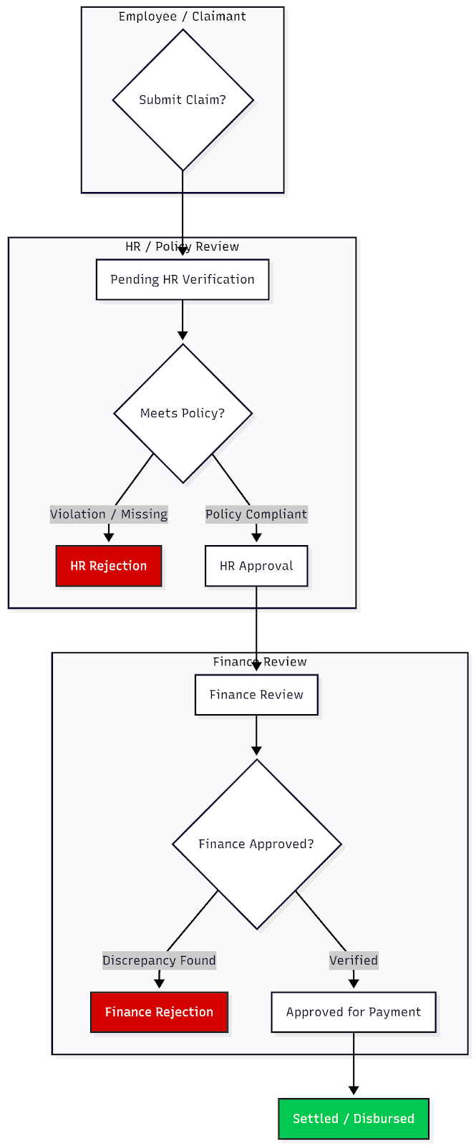
10
WORK FLOW DIAGRAM
This workflow illustrates how employee claims are reviewed, approved,and disbursed through HR and Finance governance controls.

Slide 19
11
CLAIM PROCESSING SCENARIOS
This section explains how the system responds to claim submissions under successful approvals and rejection scenarios.

Slide 20
12
CLAIM APPROVAL – SUCCESS SCENARIO
USER ACTIONS
SYSTEM ACTIONS
  Employee submits a medical claim with required documents
  HR Head verifies policy compliance and approves
  Finance reviews and confirms payment
  Claim added to Pending HR Verification
  Automatic notification sent to Finance after HR approval
  Claim marked as Settled / Disbursed
  Utilized amount updated automatically
  Employee notified upon payment completion
Ensures fast processing, policy compliance, and accurate balance tracking.

Slide 21
13
CLAIM REJECTION
USER ACTIONS
SYSTEM ACTIONS
  HR Head reviews the submitted claim
  Policy non-compliance or invalid documentation identified
  Claim status updated to Rejected
  Claimant notified via email
  Claim is closed with no further processing
Ensures strict policy compliance and clear closure of non-eligible claims.

Slide 22
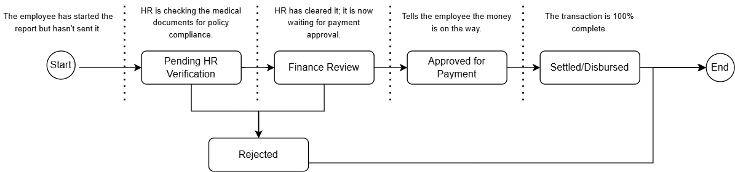
14
STATE FLOW DIAGRAM

Slide 23
KEY AUTOMATION & GOVERNANCE CONTROLS
  Automated routing between Employee, HR, and Finance
  Clear separation of duties across roles
  Real-time balance updates upon payment confirmation
  Full audit trail for compliance and reporting
  Automated notifications at each stage

Slide 24
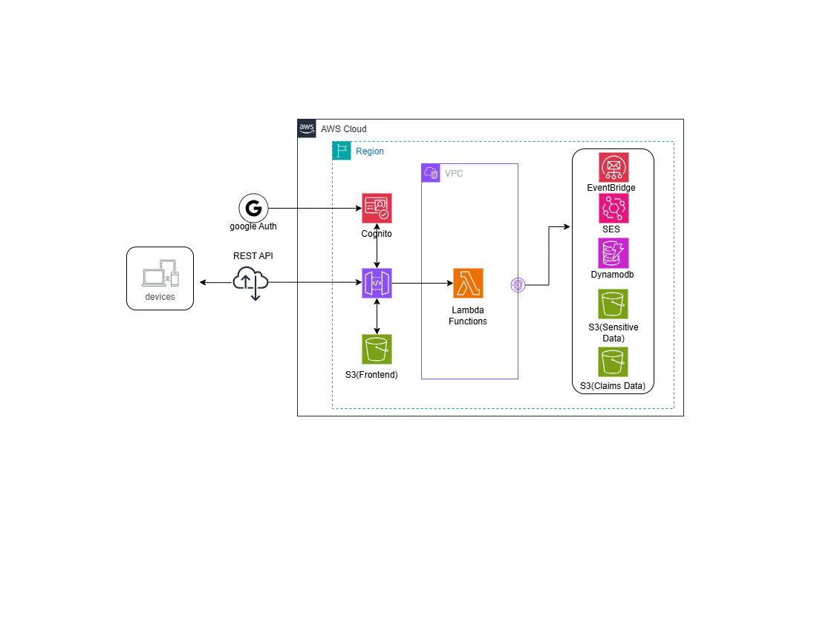
15
HIGH LEVEL ARCHITECTURE DIAGRAM

Slide 25
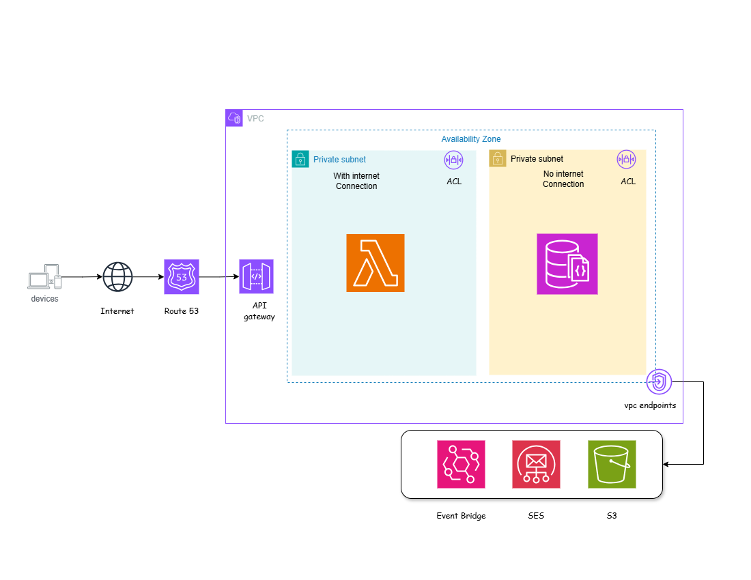
16
DEPLOYMENT ARCHITECTURE DIAGRAM

Slide 26







17
AWS SERVICES AND ALTERNATIVES
Lambda
EC2
DocumentDB
DynamoDB
API gateway
ALB

Slide 27
THANK
You!

